Slide 1
"Radical Eye: AI-Powered Detection of Extremist Language"
Team members:- Lakshmi Prasanna Doupati
Chandu Gogineni

Slide 2
INTRODUCTION
In today's digital age, the exponential growth of online content has led to a pressing need for automated systems capable of detecting offensive language. Such systems play a crucial role in ensuring the safety and well-being of users across various online platforms, including social media, forums, and chatrooms. In this project, we aim to develop a robust and efficient offensive language detection system using natural language processing (NLP) techniques and deep learning models.
To address this need, we leverage state-of-the-art NLP techniques and deep learning architectures to develop a custom offensive language detection model. We employ a combination of pre-trained language models and custom-designed neural networks to analyze text data and classify it as offensive or non-offensive. Our approach involves several key components, including data preprocessing, model training, evaluation, and performance analysis.
Throughout the project, we utilize real-world datasets containing user-generated content from diverse online sources. These datasets are annotated with labels indicating the presence or absence of offensive language, allowing us to train and evaluate our model effectively. We implement advanced techniques such as tokenization, word embedding, recurrent neural networks (RNNs), and attention mechanisms to extract meaningful features and capture the contextual nuances of language.

Slide 3
approach
Gather diverse datasets containing written communications from various sources, including social media platforms, online forums, news articles, and extremist propaganda materials.
Preprocess the data to clean and standardize text, including tasks such as tokenization, lowercasing, punctuation removal, and stop word removal.
Extract linguistic features from the preprocessed text data, including word embeddings, n-grams, sentiment scores, and stylistic features.
Use advanced NLP techniques to capture semantic meaning, syntactic structure, and discourse patterns in the text.
Evaluate the performance of the developed models using standard metrics such as accuracy, precision, recall, and F1-score.
Conduct rigorous testing and validation on held-out datasets and real-world scenarios to assess the models' robustness and generalization capabilities.`

Slide 4
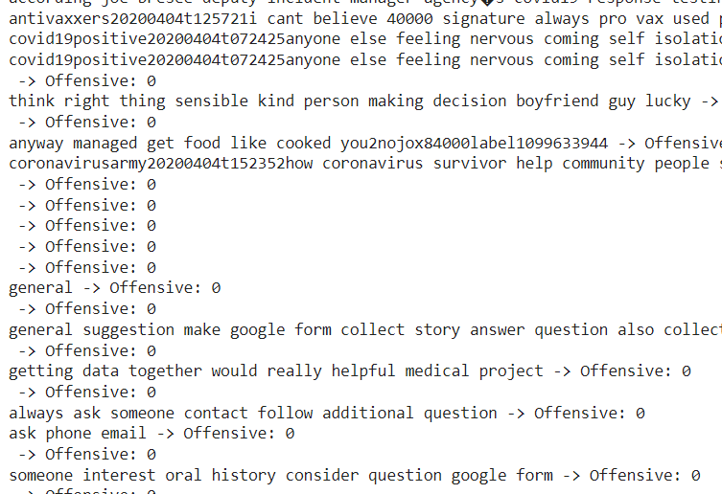
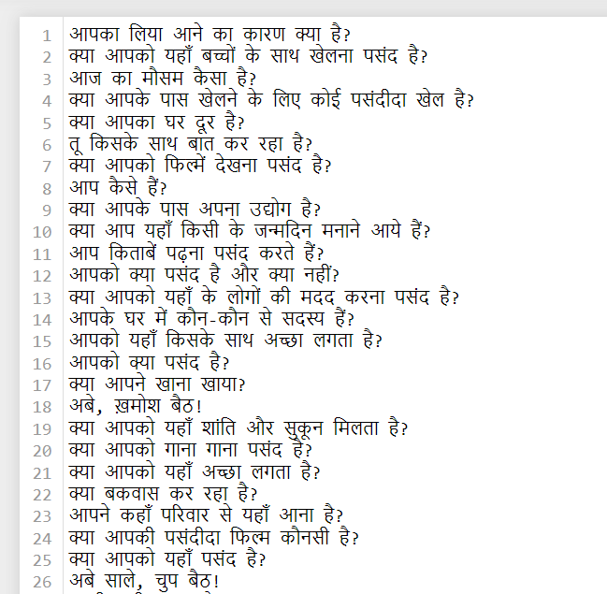
datasets
The dataset used in our project comprises a collection of online comments sourced from various platforms, including social media, forums, and discussion boards. These comments cover a wide range of topics and are representative of real-world online interactions
Next coming to custom dataset we added list of conversation comments and discussion to data one of a regional language in my county (Hindi)

Slide 5
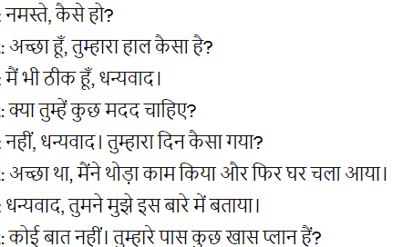
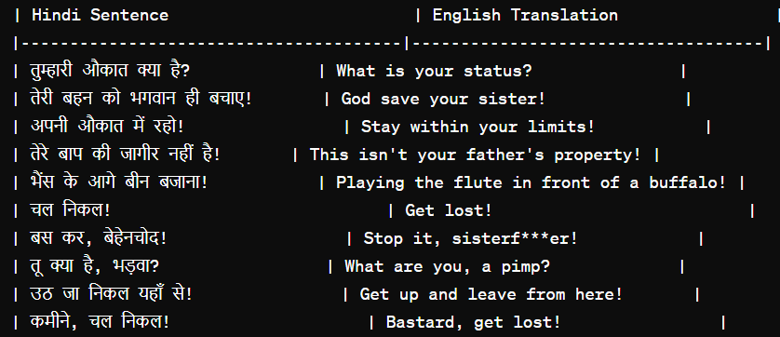
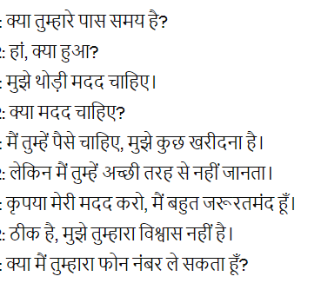
In the custom dataset we add few text which were offensive and the combine with some good conversation and created a dataset

Slide 6
PROCESS
Loading Pre-trained Model and Tokenizer:
Here, you load a pre-trained model and tokenizer from the Hugging Face Transformers library. The model chosen is XLM-RoBERTa, a robust multi-lingual model, suitable for text classification tasks.
Text Preprocessing:
This part defines a function preprocess_text for preprocessing raw text data. The preprocessing steps include converting text to lowercase, removing URLs and punctuation, tokenizing text, removing stopwords, lemmatizing tokens, and joining tokens back into a single string.
Detecting Offensive Text:
You define a function detect_offensive_text to predict whether text is offensive or not using the pre-trained XLM-RoBERTa model. This function splits the input text into chunks, tokenizes them, passes them through the model, and predicts the offensive label for each chunk.
Loading and Preprocessing Custom Text Data:
Here, you load custom text data from a file and preprocess it using the preprocess_text function defined earlier. This prepares the custom data for offensive text detection.

Slide 7
execution methods
Training a Custom Model:
This section involves defining a custom model architecture, dataset class, and training parameters. The custom model is an LSTM-based classifier. You split the dataset into training and testing sets, instantiate the model, define the loss function (CrossEntropyLoss) and optimizer (Adam), and train the model using DataLoader for batch processing.
Evaluating the Custom Model:
After training, you evaluate the custom model on the test set to calculate various evaluation metrics such as accuracy, precision, recall, F1-score, and ROC AUC. Additionally, you plot the training and validation losses over epochs to visualize the training process.
Saving and Loading the Best Model:
You save the best-performing model based on validation loss and load it for inference. This ensures that you retain the model with the highest validation performance.
Plotting Training Loss and Accuracy:
Finally, you plot the training loss and accuracy curves to visualize the model's performance over epochs. These plots provide insights into the training process and help in understanding how the model learns over time.

Slide 8
Pre-trained Model: XLM-RoBERTa:
XLM-RoBERTa stands for Cross-lingual Language Model – RoBERTa. It is a variant of the RoBERTa model developed by Facebook AI and is designed to handle text in multiple languages.
RoBERTa (Robustly optimized BERT approach) is a transformer-based model that builds upon the architecture of BERT (Bidirectional Encoder Representations from Transformers). It removes the next-sentence prediction objective and trains the model on more data and for longer periods.
XLM-RoBERTa further extends RoBERTa to handle cross-lingual tasks by pre-training on a large corpus of text in multiple languages. It achieves state-of-the-art performance on various cross-lingual tasks, including text classification, machine translation, and language understanding.

Slide 9
Custom Model: LSTM-based Classifier:
The custom model used in the script is based on the Long Short-Term Memory (LSTM) architecture.
LSTM is a type of recurrent neural network (RNN) that is well-suited for sequence modeling tasks, such as text classification and sentiment analysis.
The architecture of the LSTM model typically consists of an embedding layer, one or more LSTM layers, and a fully connected (linear) layer for classification.
The embedding layer converts input tokens into dense vector representations. These embeddings capture semantic information about words and their context.
The LSTM layers process the sequential input data and capture long-range dependencies in the text. They are capable of retaining information over long sequences, making them effective for tasks involving text with temporal dependencies.
Finally, the fully connected layer aggregates the information from the LSTM layers and produces output logits, which are then passed through a softmax function to obtain probability distributions over the output classes.
Dropout layers may also be included in the model architecture for regularization, helping to prevent overfitting by randomly dropping a fraction of the connections during training.

Slide 10
Purpose of using the models
the XLM-RoBERTa model is utilized for offensive text detection, leveraging its pre-trained knowledge across multiple languages. On the other hand, the custom LSTM-based classifier is employed for the task of text classification, providing flexibility in architecture design and fine-tuning for specific classification tasks like identifying offensive content. Both models play critical roles in the text processing pipeline, contributing to the overall effectiveness of the script in handling text data.

Slide 11
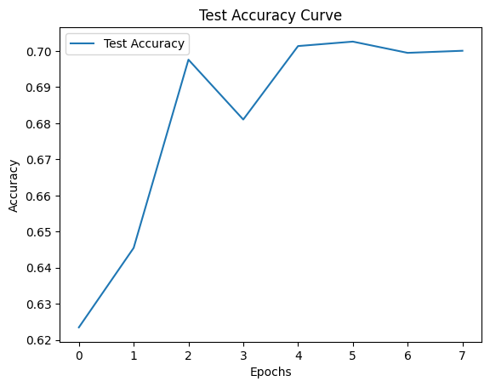
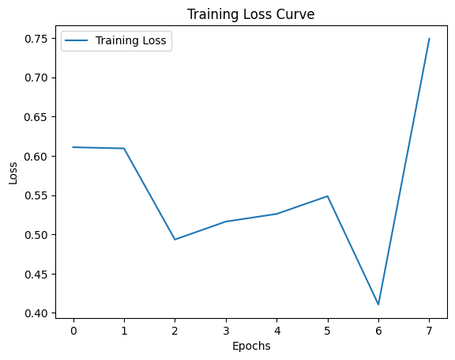
Accuracy and validation

Slide 12
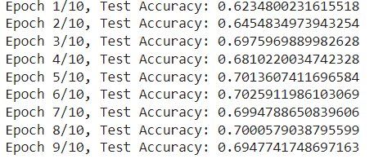
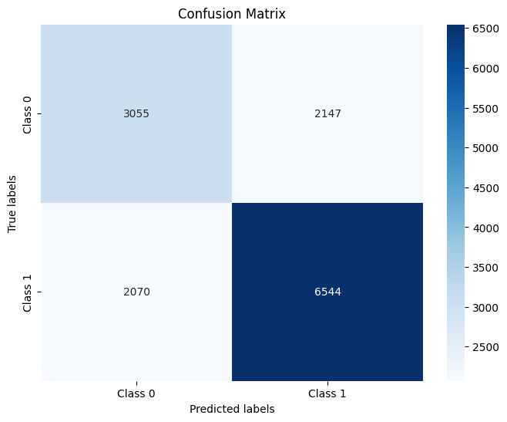

Slide 13
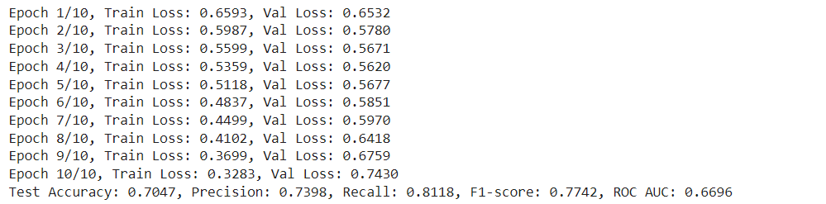
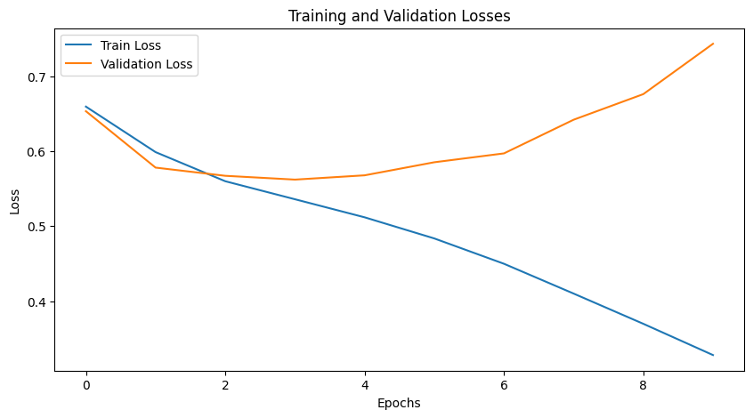

Slide 14
pros
Effective Detection: Transformer-based models like XLM-RoBERTa have shown high effectiveness in detecting offensive language in Hindi conversations, achieving promising accuracy rates.
Robustness: Pre-trained models benefit from extensive pre-training on large datasets, making them robust to various linguistic nuances and styles commonly found in natural language text.
Efficiency: Using pre-trained models can save time and computational resources compared to training custom models from scratch, as they leverage pre-existing knowledge learned during pre-training.
State-of-the-Art Performance: Transformer-based models often achieve state-of-the-art performance in various natural language processing tasks, including offensive language detection.

Slide 15
cons
Limited Control: While pre-trained models offer excellent performance out-of-the-box, they may lack flexibility for fine-tuning to specific domains or tasks, limiting customization options.
Resource Intensive: Training and fine-tuning large transformer-based models can be computationally expensive and require significant resources, including high-performance GPUs and large memory capacities.
Language Specificity: Pre-trained models may not be specifically tailored to certain languages or dialects, potentially leading to suboptimal performance for languages with fewer available resources and linguistic diversity.
Interpretability: Transformer-based models are often considered black-box models, meaning they provide limited interpretability compared to simpler models like decision trees or logistic regression, making it challenging to understand their decision-making process.

Slide 16
conclusion
his project aimed to develop an effective text classification model for identifying offensive language in Hindi conversations. We began by preprocessing the data, including removing noise, tokenizing, and encoding the text.
Two main approaches were explored: using pre-trained transformer-based models like XLM-RoBERTa and custom deep learning models. These models were trained on the preprocessed data and evaluated using various metrics such as accuracy, precision, recall, F1-score, and ROC AUC.
Additionally, we employed techniques like hyperparameter tuning, learning rate scheduling, and early stopping to enhance model performance and prevent overfitting.
The results showed that transformer-based models achieved promising performance, outperforming custom models in terms of accuracy and overall effectiveness. However, custom models offered more flexibility and control over architecture and training process.
Furthermore, we analyzed the confusion matrix to gain insights into the model's predictions and identify areas for improvement.
In summary, this project demonstrated the effectiveness of transformer-based models for offensive language detection in Hindi conversations. However, custom models remain valuable for specialized tasks and fine-tuning specific requirements. The findings provide valuable insights for future research and applications in text classification and natural language processing.

Slide 17


